Slide 1
OPERATION ARCTIC CITADEL (OPAC)
Road to war and situation
CAO: 2024-12-26
Version: 0.1
Notes:
Changes:
1.1: Minor updates to correct the brief IAW actual situation.

Slide 2
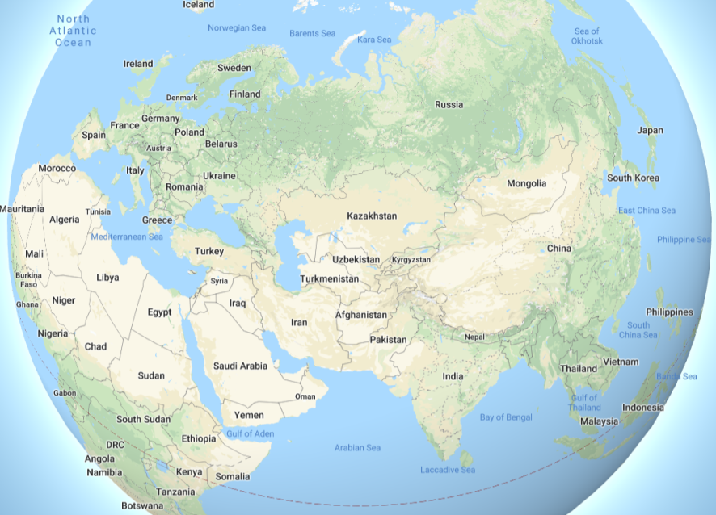
GLOBAL SITUATION
Europe:
Russia have been threatening to invade Baltic countries as a response to NATO actions. NATO have deployed forces to the Baltic to reinforce the country and deter a Russian attack.
Asia:
After months of deteriorating in relations between US and China, the situation escalated a few weeks ago with fighting breaking out between Chinese and US fleets in the South China Sea.
While both sides are trying to contain the conflict and prevent it from escalating, both China and the US has been reinforcing their bases in the region.
Russia has declared its full support in Chinese territorial claims and condemned US "Western intervention in Asia's affairs“
As of this time there's no clear end to the conflict and we can expect the US to focus its attention - both in the diplomatic arena as well as the prioritization of military and economical assets - in South-East Asia rather than the Middle-East.
Diplomatic:
Due to the current situation in Europe and Asia, Russia and China are boycotting the United Nations Security Council.
SOUTH CHINA SEA
BALTIC
OPAR AREA OF OPERATIONS
Middle East (OPAR Area of Operations)
See next slides

Slide 3
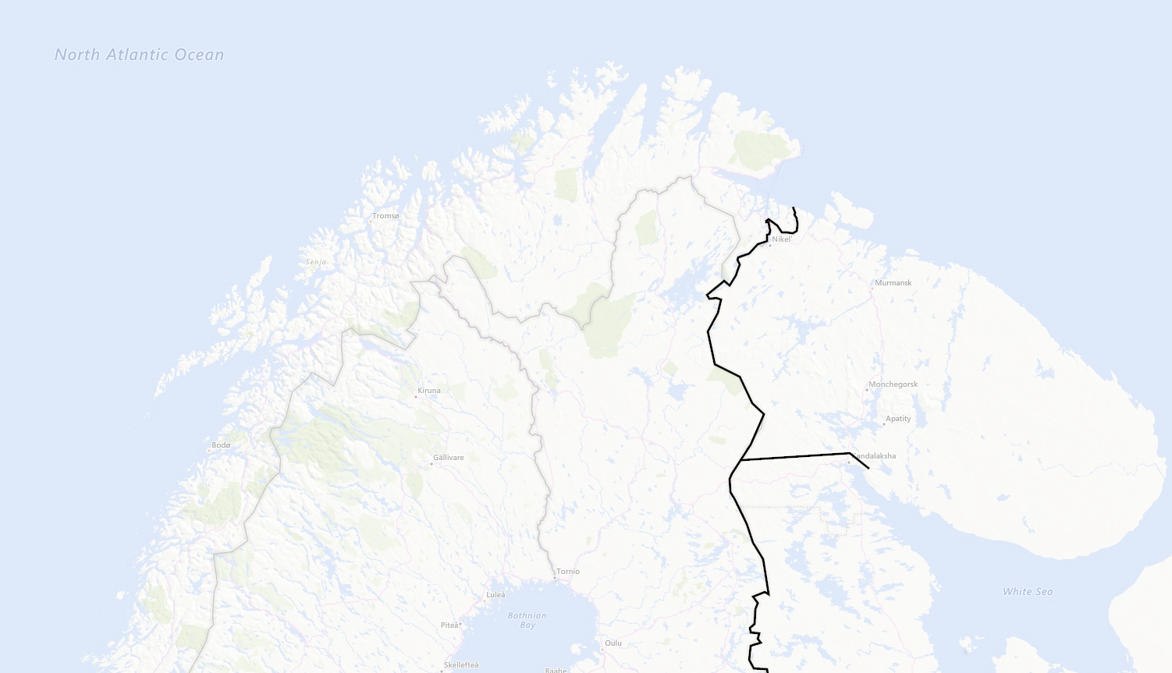


LOCATIONS
NORWAY
NOTIA
SWEDEN
FINLAND
KAMBILAND

Slide 4
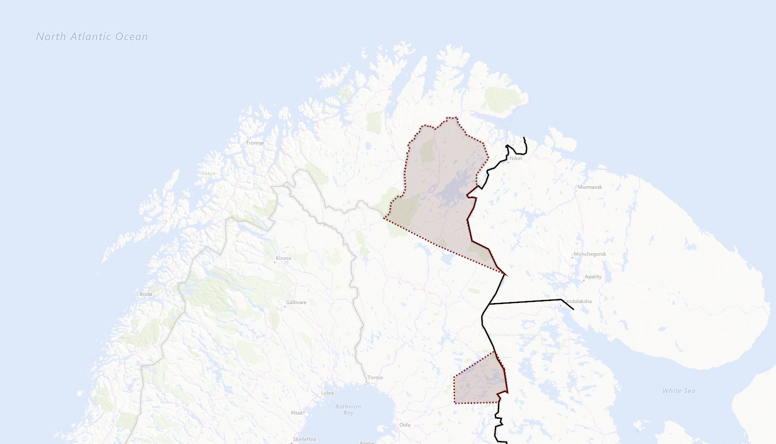


CONTESTED TERRITORY
Notian claims in Northern Finland
FINLAND
Kambiland settlements in Finland

Slide 5

SITUATION & TIMELINE (1 of 2)
Time at start of campaign: 20th September 2011 (D0)
Notia have over years claimed part of Northern Finland as part of Notia after WW2.
The last year Notia have increased their posture toward Finland and had public statement regarding protecting Notian nationals in Notian claimed territory in Northern Finland while also expressing offensive ambitions and need to create strategic depth and move defenses forward.
Notia have expressed concern about the Notian nationals living in Northern part of Finland and have urged UN to protect their rights.
Notia have expressed a willingness to intervene to protect Notian nationals everywhere in the world.
The last 3 weeks we have seen a buildup of military forces in Notia indicating higher activity than normal. Notia have stated that this is part of their national exercise FROST. The exercise is scheduled to last until 23rd of September 2011.
In the area of Kuusamo in Finland there are several settlements that have a majority of Kambiland inhabitants.
Kambiland have not an overt offensive posture in the same manner that Notia and have traditionally had good relations with Finland regarding the Kamibland nationals in Finland
Notian claims in Northern Finland
Kambiland settlements in Finland

Slide 6
SITUATION & TIMELINE (1 of 2)
Time at start of campaign: 20th September 2011 (D0)
Finland are feeling threatened and are assessing the situation as serious and that Notian plans to follow up threats and seize the Notian claims territory in Northern Finland before 2012.
Finland have asked for support from its close allies, and a close group of allies have created Combined Joint Task Force – 23 (CJTF 23) with both air, ground and naval units from different countries.
CJTF-23 aims to bolser Finnish defenses and deter and prevent an invasion from Notia.
CJTF-23 are tasked with creating contingency plans for attack on Notia to destroy Notian offensive capability if tasked by political authorities.
Notian claims in Northern Finland
Kambiland settlements in Finland

Slide 7
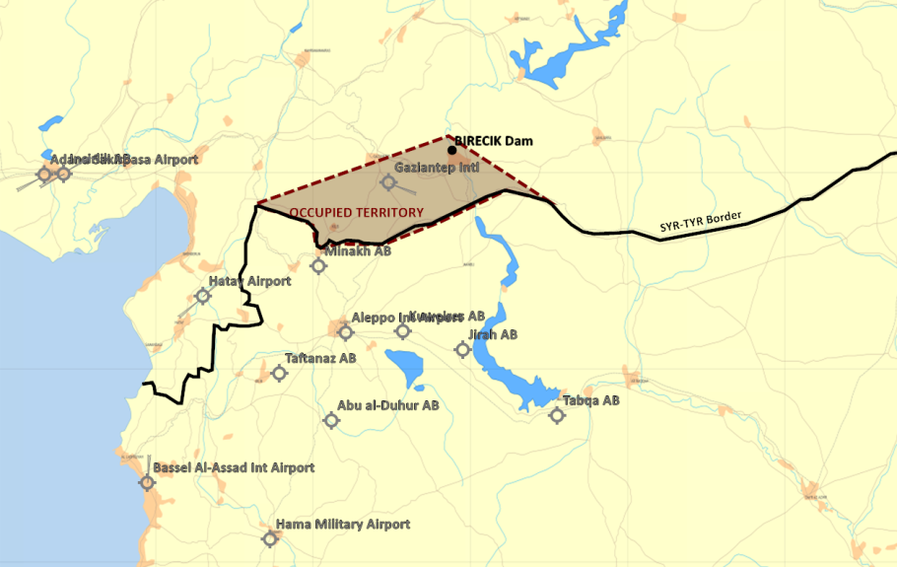
SITUATION & TIMELINE
Time now: Last week of august 2011.
1st July 2011 , Syria conducted a surprise attack against Turkey in order to seize control of the Birecik Dam.
Syrian objectives in Turkey is assessed to be
Seize control of the Birecik dam to gain a strategic advantage by controlling the source of fresh water and electrical power in the area.
Gaziantep airport is occupied to deny Turkey an airport which can be used to receive supplies/reinforcements closest to the occupied territory
Syria will likely consolidate the occupied territory without attacking the city of Gaziantep.
At the same time Syria also conducted a surprise test of its chemical weapon
It is assessed as a sign of resolve and show of force from Syrian government, the test likely aimed toward Turkey and NATO
Syria also mobilized its 3rd Corps of the border of Israel to protect Damascus from any action from Israel
2nd July: NATO & EU expressed support to Turkey and condemned the Syrian attack.

Slide 8
SITUATION & TIMELINE
5th of July: UN Security Council (UNSC) expressed concern on the situation and asked the parties to end the violence and resolve the conflict with diplomatic means.
7th of July: After a week of fighting, the Syrian forces effectivly defeated Turkish forces and are now in control of its main objectives (Birecik Dam and Gaziantep airport )
8th of July: Turkey called for a UN Security Council Resolution for Syria to withdraw from the occupied territory
10th of July: UN Security Council released resolution 3263: S/RES/3263 (2011) which states that Syrian action is against international law, and Syria should return its forces back to the borders from before 1st August. The resolution also call on Syria to allow inspectors from UN to inspect the chemical weapon program
14th of July: UN Security Council released resolution 3266: S/RES/3266 (2011) which reaffirmed UNSCR 3263 and imposed economic sanctions against Syria to make it comply with UNSCR 3263.
15th July: A coalition of the willing is beeing formed. Combined Joint Task Force 82 is created to form the international response to support Turkey against Syrian aggression.
1st August: UN Security Council released resolution 3274: S/RES/3274 (2011) which gave Syria a deadline of 31st August 2011 to comply with UNSCR 3263 and withdraw from Turkey and stop all chemical weapons testing. The resolution empowered states to use "all necessary means" to force Syria out of Turkey and to stop Syria from using chemical weapons after the deadline.
Throughout August: CJTF builds up combatpower in the region. Syria prepares defensive positions and the situation is static while the time toward the deadline is counting down. Syria used the august effectively and resupplied its military forces so their forces are fully equipped and combat ready.

Slide 9
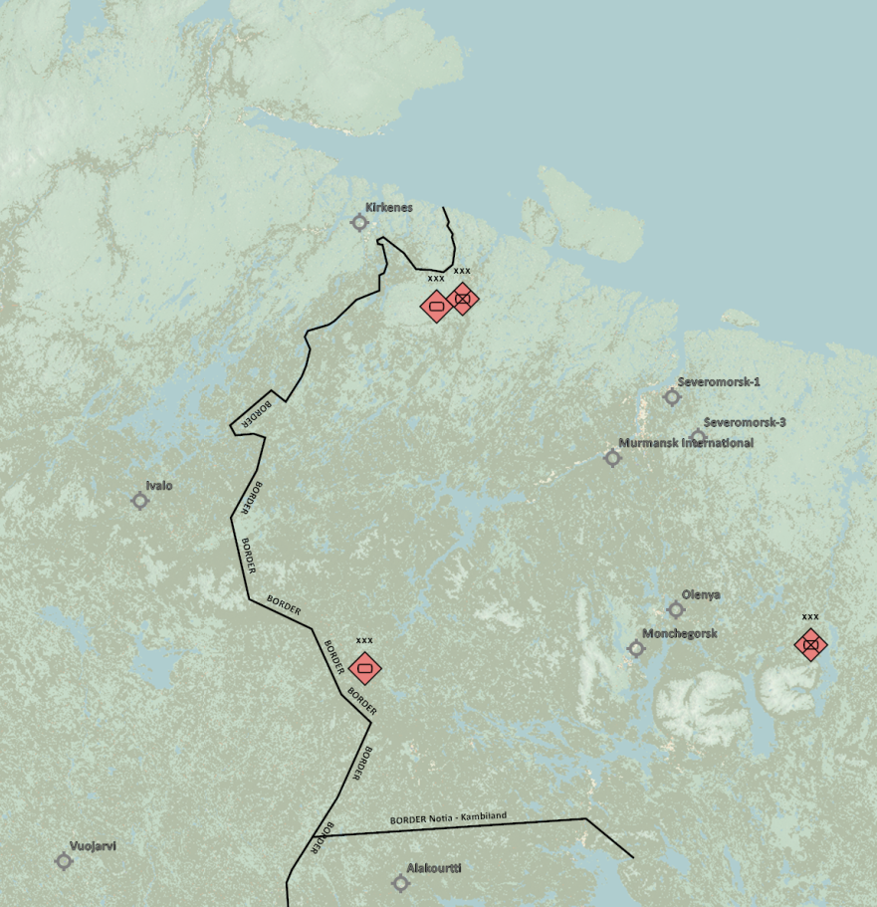
MILITARY SITUATION
Notia ground force dispositions:
1st Corps have left bases and are in training area conducting exercise FROST.
2nd Corps have partially left base complex and are taking part in exercise FROST.
3rd Corps have left bases and are in training area conducting exercise FROST.
4th Corps are currently not mobilized and are at homebase.
Air Forces IAW INTREP VID OPAC-001 - Enemy Air Assets in Notia and Kambiland
Notian strategic IADS IAW: INTREP VID OPAC-002 - Notia IADS
For details see intelligence page on OPAC briefing page: OPAC Intelligence (WIP/TBI)
Kambiland ground force disposition:
Kambiland forces are at home bases
2nd Corps
1st Corps
3rd Corps
4th Corps

Slide 10
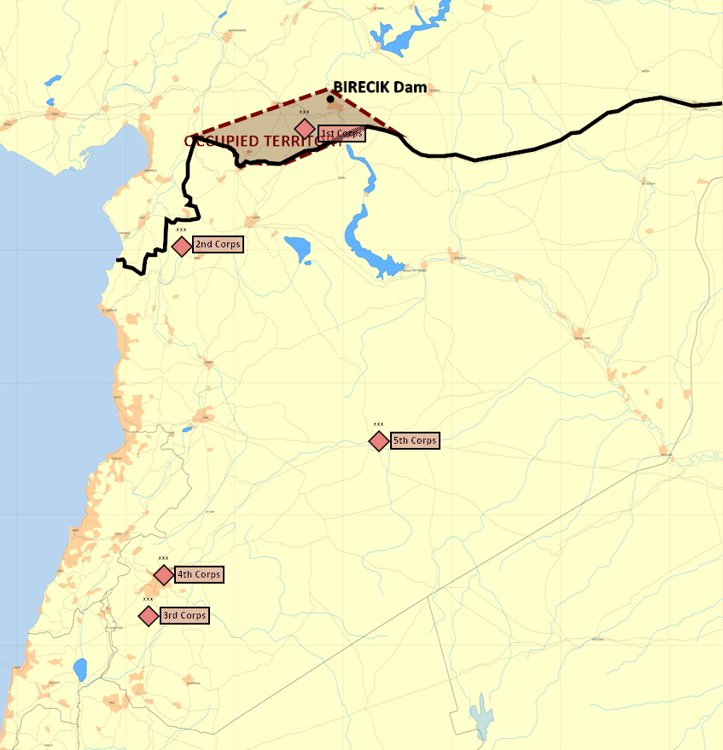
MILITARY SITUATION
Syria ground force dispositions is as follows:
1st Corps have seized the occupied territory and are in defensive positions to defend Syria's newly seized area.
2nd Corps have left their bases and are lining up on the border to the north in defensive positions
3rd Corps have mobilized and are established in defensive positions along the border to Israel
4th Corps are conducting rear duty assignments and protecting Damascus
5th Corps are in their base in Palmyra, finishing their workup to be prepared for operations.
Air Forces IAW INTREP VID OPAR-001 - Syrian Air Force
Syrian strategic IADS IAW: INTREP VID OPAR-002 - Syrian IADS
For details see intelligence page on OPAR briefing page: OPAR Intelligence

Slide 11
ACTORS - Allied
Norway
Norway have granted overflight and movement rights for allied forces in support of Finland.
Norway are supporting with military aid, and the flow of goods to Finland.
Norway have allowed bases to be used for operations toward Notia or Kambiland without restrictions ( Bodø, Andøya, Bardufoss and Banak).
Finland
Finland is the country that have asked for support from allies.
Finland are hosting CJTF-23 operations from all bases and infrastructure.
Sweden
Sweden have granted overflight and movement rights for allied forces in support of Finland.
Sweden are supporting with military aid, and the flow of goods to Finland.
Sweden have not allowed Swedish bases to be used for operations toward Notia or Kambiland

Slide 12
ACTORS - Adversaries
Notia
Notia is a vast, iron-fisted state reminiscent of the Soviet Union at the height of the Cold War. Governed by a single-party regime, power is centralized in the Supreme Council, presided over by a stern Premier who controls nearly every aspect of civilian and military life. The nation’s sprawling industrial complexes churn out tanks, aircraft, and propaganda alike, reinforcing a massive military apparatus. Despite the strict internal security imposed by the secret police, Notia’s people hold onto a sense of collective pride in their shared heritage and technological achievements. This mix of authoritarian control and fierce national identity makes Notia a formidable force on the global stage.
Kambiland
Kambiland is the “little brother” to Notia, forged from the cultural tapestry of shared bond of hardness. An authoritarian regime led by a formidable Supreme Leader wields near-total power, upheld by a sprawling security apparatus that cracks down on any hint of dissent. Despite longstanding economic challenges, vast natural resources and fervent nationalism fuel Kambiland’s aspirations. Its strategic alliance with Notia serves to bolster both nations’ military and political leverage, reflecting a bond that balances regional dominance with cultural ties. While a powerful state in its own right, Kambiland’s identity and future remain closely linked to the ambitions of its elder ally
Enemy: is actively opposed or hostile to CJTF and friendly forces.
Adversary: opponent in a contest, conflict, or dispute toward CJTF and friendly forces.
Neutral: not supporting or helping either side in a conflict, disagreement, etc.; impartial.

Slide 13

ACTORS - Adversaries
Democratic Union of Socialist States (DUSS)
China, Notia and Kambiland are allied as part of DUSS.
China
China are the lead nation of DUSS and are projecting power worldwide using air and maritime assets.
Syria
Syria is affiliated with DUSS and a supporting member, but not yet a full member of the alliance.
Iran
Iran is affiliated with DUSS and a supporting member, but not yet a full member of the alliance.
Libya
Libya is affiliated with DUSS and a supporting member, but not yet a full member of the alliance.
Enemy: is actively opposed or hostile to CJTF and friendly forces.
Adversary: opponent in a contest, conflict, or dispute toward CJTF and friendly forces.
Neutral: not supporting or helping either side in a conflict, disagreement, etc.; impartial.

Slide 14
ACTORS - Adversaries
The Iron Resolve
Terror group in support of Notia.
Close ties to Notia special forces.
The Dawn’s Vengance
Terror group in support of Kamibland.
Close ties to Kambiland special forces.
Enemy: is actively opposed or hostile to CJTF and friendly forces.
Adversary: opponent in a contest, conflict, or dispute toward CJTF and friendly forces.
Neutral: not supporting or helping either side in a conflict, disagreement, etc.; impartial.
Notes:
Notia – The Iron Resolve The Iron Resolve is a clandestine group operating along the northern frontier of Notia, driven by an unyielding commitment to reclaim the territory they believe was unjustly seized by Finland. They work covertly, engaging in calculated acts of sabotage and forming alliances with sympathetic factions determined to see the disputed lands returned. Though they often present themselves as patriotic liberators, their methods can be ruthless—targeting key border infrastructure and pressuring the Finnish authorities through a mix of propaganda and high-stakes incursions. The organization is led by the formidable General Boris Ulyanov, a rumored veteran of foreign conflicts whose tactical prowess has proven instrumental in keeping the Iron Resolve’s ambitions alive.
Kambiland – The Dawn’s Vengeance Emerging from Kambiland’s mountainous border regions, The Dawn’s Vengeance wages a relentless campaign to restore the territory they claim was taken by Finland generations ago. Drawing support from local tribes and nationalist movements, they orchestrate daring cross-border raids designed to destabilize Finnish control over the contested area. Although they portray themselves as freedom fighters for Kambiland’s sovereignty, their activities occasionally draw international condemnation for their willingness to use violent tactics. At the helm of The Dawn’s Vengeance is the enigmatic Comrade Vladislav Makarov, a figure admired by his followers for his fervent speeches on national unity and feared by opponents for his uncompromising stance on territorial reclamation.

Slide 15
ACTORS - Neutral
Lebanon
Enjoys good relations with Syria
Have had a neutral stance toward Israel the recent years.
However, Hezbollah is based in Lebanon
Jordan
Jordan have currently not taken any sides in the conflict and have expressed discontent with the Syrian invasion, but have not gone so far to condemn it, or to support CJTF operations.
Israel
The Israeli Defense Force (IDF) has been has been undergoing a slow transformation since the 2006 war in Lebanon. More effort spent on training for counter-guerrilla scenarios and reduced focus on large-scale combat scenarios as are expected against the Syrian armed forces.
Israeli air-force (IAF) have conducted a limited number of air attacks in Syria against strategic targets (Iranian targets and Syrian targets) the last decade.
Along the Lebanese border, the IDF is engaged in constantly high level of tension facing Hezbollah in Southern-Lebanon
Israel are diplomatically supporting the coalition

Slide 16
ACTORS - Adversaries
Syria
The Syrian leadership party has gone weaker in past months and is seeking to re-affirm itself as strong and aggressive by pursuing a militant stance.
With intent to gain access to more economical assets and becoming a dominant , regional superpower, Syria set an ambitious goal to launch a major military campaign against its historical enemy in Turkey.
This approach become more appealing with the US being occupied with its conflict with China and lack of apparent interest in Middle-East affairs
In the recent years, Syria has been hosting large numbers of foreign military units:
Russian air force has been staging in Syrian airbases as part of a strategic agreement of providing Russia with a naval base and part of a airfield
Iranian revolutionary guards are very active in establishing bases to be used for possible operations against Israel in the event of a conflict between the two countries. Those bases and efforts have been the targets of numerous air raids by Israeli air force.

Slide 17
ACTORS – Adversaries
Iran
Iran also seeks to increase its influence in the region. Iran aspires to achieve a status of dominant power. Iran invests effort in building capabilities against Israel in the following areas:
Build deterrence against Israel by staging forces close to Israeli border. Such force can include ballistic missiles as well as militants which would can be used to retaliate against Israel
Supporting Hezbollah in military equipment, training camps and funding to be used as an additional deterrence tool against Israel
Hezbollah
Hezbollah is maintaining presence in Southern Lebanon and in the Syrian side of the Golan-Heights to inflict pressure on Israel and deter against possible Israeli incursions into Lebanon (Although not initiating escalation of the situation without specific instructions of support from Iran)
Russia
Russia has its strategic interests in Syria:
The TARTUS naval base (Russian's only major port in the Eastern Mediterranean) operated by Russian personnel (advisors and fleet shipyard) and defended by SAM units manned by Russian servicemen.
The presence of military advisors and aerial assets used for infliction of power and influence in the Middle East
Bassel Al-Assad Airport is the airbase used for Russian operations in the middle east. The last months there have only been sporadic Russian activity at the base.
China
Currently unknown if China have any interest in the campaign in Syria. However, likely that CHINA will use any mean necessary to undermine coalition effort throughout the world

